Slide 1
Consultant Grades
FDOT D5
Consultant Project Management

Slide 2
Consultant Grades SMART Goal(all PM’s)
Description:
Comply with all grading requirements and ensure no overdue grades.
Definition:
To meet these expectations: Employee will be rated on a project by project basis on completing
Consultant Evaluations for each milestone then averaged for all projects.
Milestones are as follows:
Interim (once a year)
Phase I Line and Grade Meeting
Phase II Plans Review
Phase III Plans Review
Plans Update Review
Letting Date
5 - Consultant evaluations completed less than 62 Calendar days after the milestone date.
4 - Consultant evaluations completed 63 to 69 Calendar days after the milestone date.
3 - Consultant evaluations completed 70 to 76 Calendar days after the milestone date.
2 - Consultant evaluations completed 77 to 83 Calendar days after the milestone date.
1 - Consultant evaluations completed 84 or more Calendar days after the milestone date

Slide 3
Schedule Updates
Consultant Grades will be added to the schedules as follows:
Phase I Evaluation of Consultant
to begin after Phase I Line and Grade Meeting for a 62 days duration (to achieve 5).
Phase II Evaluation of Consultant
to begin after Phase II Plans Review for a 62 days duration (to achieve 5).
Phase III Evaluation of Consultant
to begin after Phase III Plans Review for a 62 days duration (to achieve 5).
Plans Evaluation of Consultant
to begin after Plans Update Review for a 62 days duration (to achieve 5).
Final Evaluation of Consultant
to begin after Letting Date for a 62 days duration (to achieve 5).

Slide 4
Send e-mail to Experts
After each milestone, the Project Manager will fill out the consultant grading excel spreadsheet and send the following email to the list below and they will delegate accordingly:
Interim (once a year)
PM & Supervisor to decide on a case by case basis
Phase I Line and Grade Meeting
Per Line and Grade Meeting Sign In Sheet
Phase II Plans Review, Phase III Plans Review, Plans Update Review
Per ERC List of Reviewers
Letting Date
Per ERC List of Reviewers for the latest Plans Submittal

Slide 5
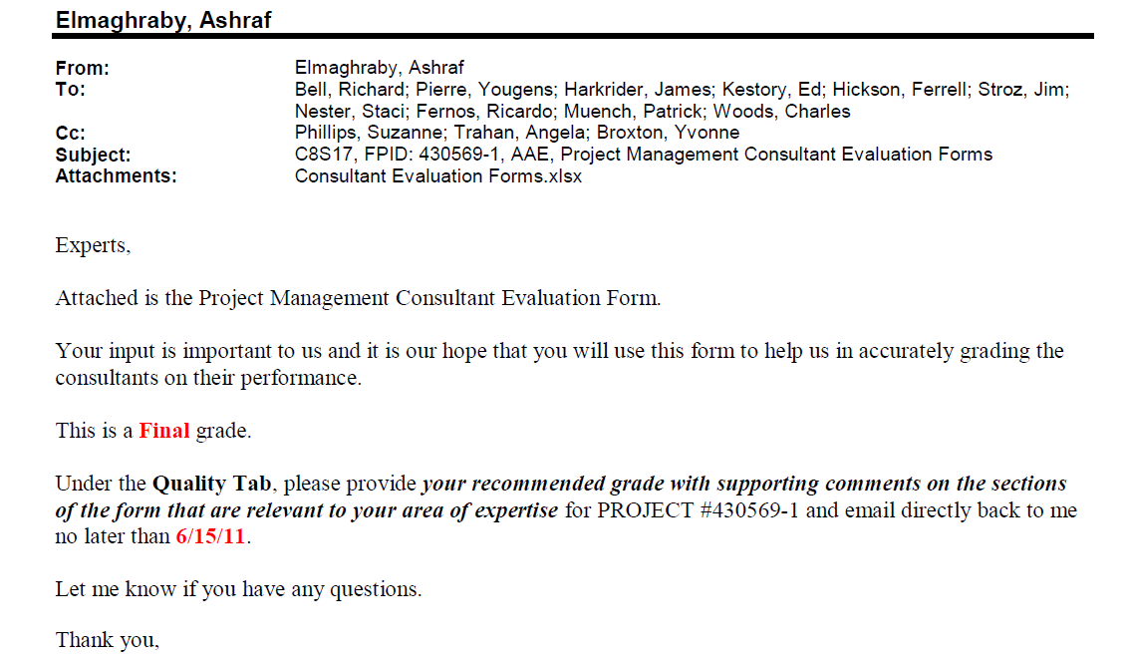
Send e-mail to Experts
Per ERC List of Reviewers

Slide 6
Compile and get Signatures
Project Manager to compile grades and have them reviewed/signed by Supervisor & DCPME.
Share Grades with Consultant
Project Manager to discuss Grades with Consultant PM via e-mail/meeting and get with Supervisor for revisions.
Approve Grades
Project Manager to give final grades to Yvonne to enter in TSO then Project Manager approve them in TSO once entered.

